Slide 1

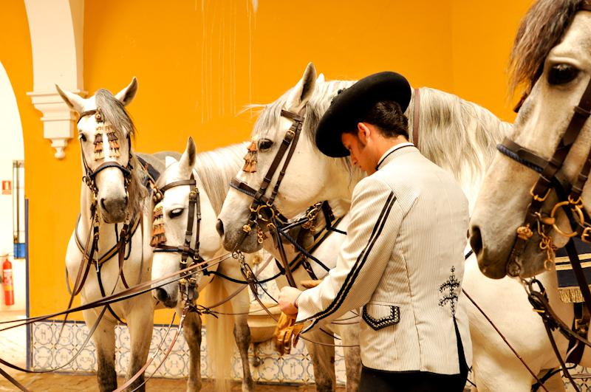
HORSEBACK ADVENTURES
TRAVEL PROGRAM
EQUESTRIAN ANDALUSIA
ESCAPE
2025
Seville, Córdoba and Granada. 3 cities and 3 rides, all packed within a week´s travel. The perfect escape to get a taste of Andalusia with visits to its most iconic cities and cultural highlights but following its horse culture and bridle paths as a guiding thread to interact with its landscape, culture and people in a much deeper way.
The various trail rides have been planned to offer the riders a diversity of landscapes; from mountainous country, to cork oak forests and meadows, cattle ranches and farmlands. As for the cultural program, Andalusia´s must-sees will be covered, but a horse-related twist in the way the trip is designed will make it clear how important horses are in the history and culture of Spain. All that, with plenty of good Spanish food and wines to soak it all in.
Highlights:
Cordoba´s Royal Stables, featuring its award-winning flamenco and horses show.
Day ride on saddle mules through Sierra de Cardeña.
Visiting Seville´s monuments on a horse-drawn buggy .
Day ride through Doñana Natural Park among Spanish fighting bulls.
Day ride on Sierra Nevada´s mountainous terrain .

Slide 2
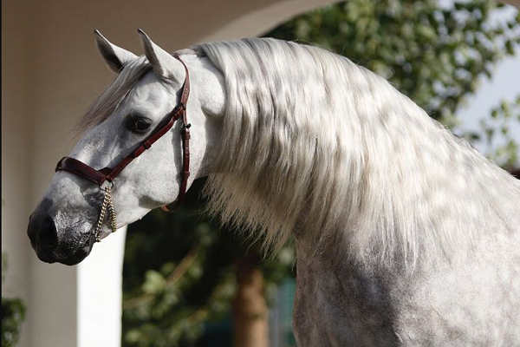
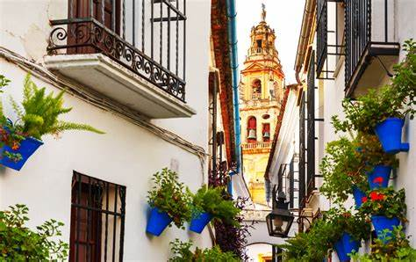
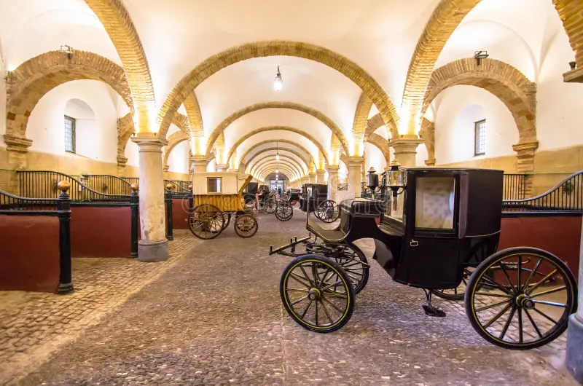
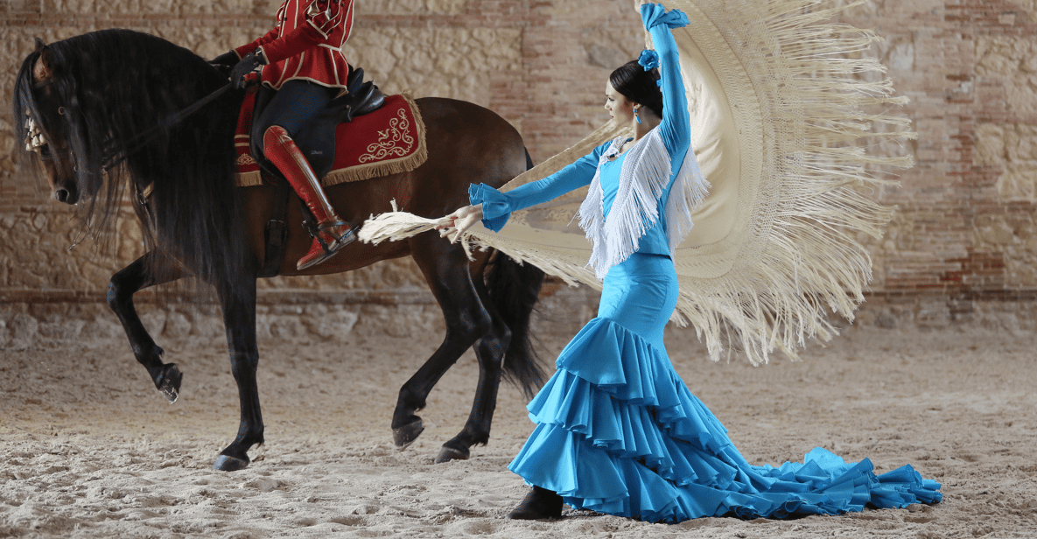
TRAVEL PROGRAM
Day 1.
Pick up in Madrid.
Córdoba: cultural crossroads and cradle of the Andalusian horse.
Pick up in hotel or airport in Madrid, morning transfer to the city of Córdoba. (4 hr. drive.)
Cordoba, was a crossroad of cultures, and its impressive Moorish architecture speaks of the times when Moors, Christians and Jews traded in this once caliphal and cosmopolitan city and horses were a symbol of power.
After lunch, will enjoy a relaxed city walk through the old town towards the Caballerizas Reales de Córdoba (Cordoba Royal Stables), dating to 1570, built over the former royal stables of the caliphal era by order of Phillip II. Caliphs and then Christian Kings kept their best studs here and it is considered the cradle of the Andalusian horse breed. They are still active today and we will enjoy their award-winning flamenco and horses show, with magnificent animals and beautiful music.
After the show, we will have a welcome dinner with traditional fare.
1st night in Córdoba., 4* accommodation.

Slide 3
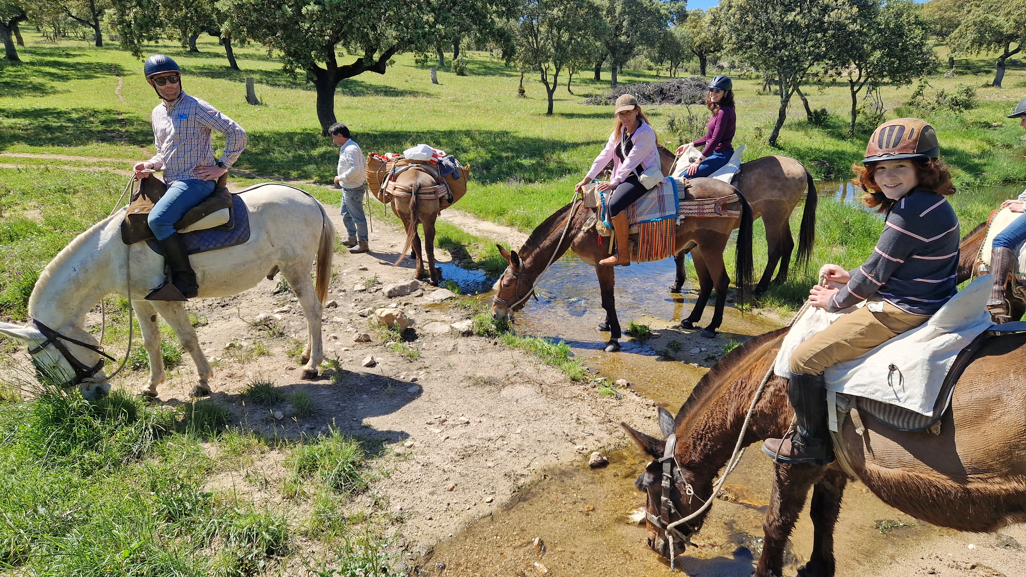
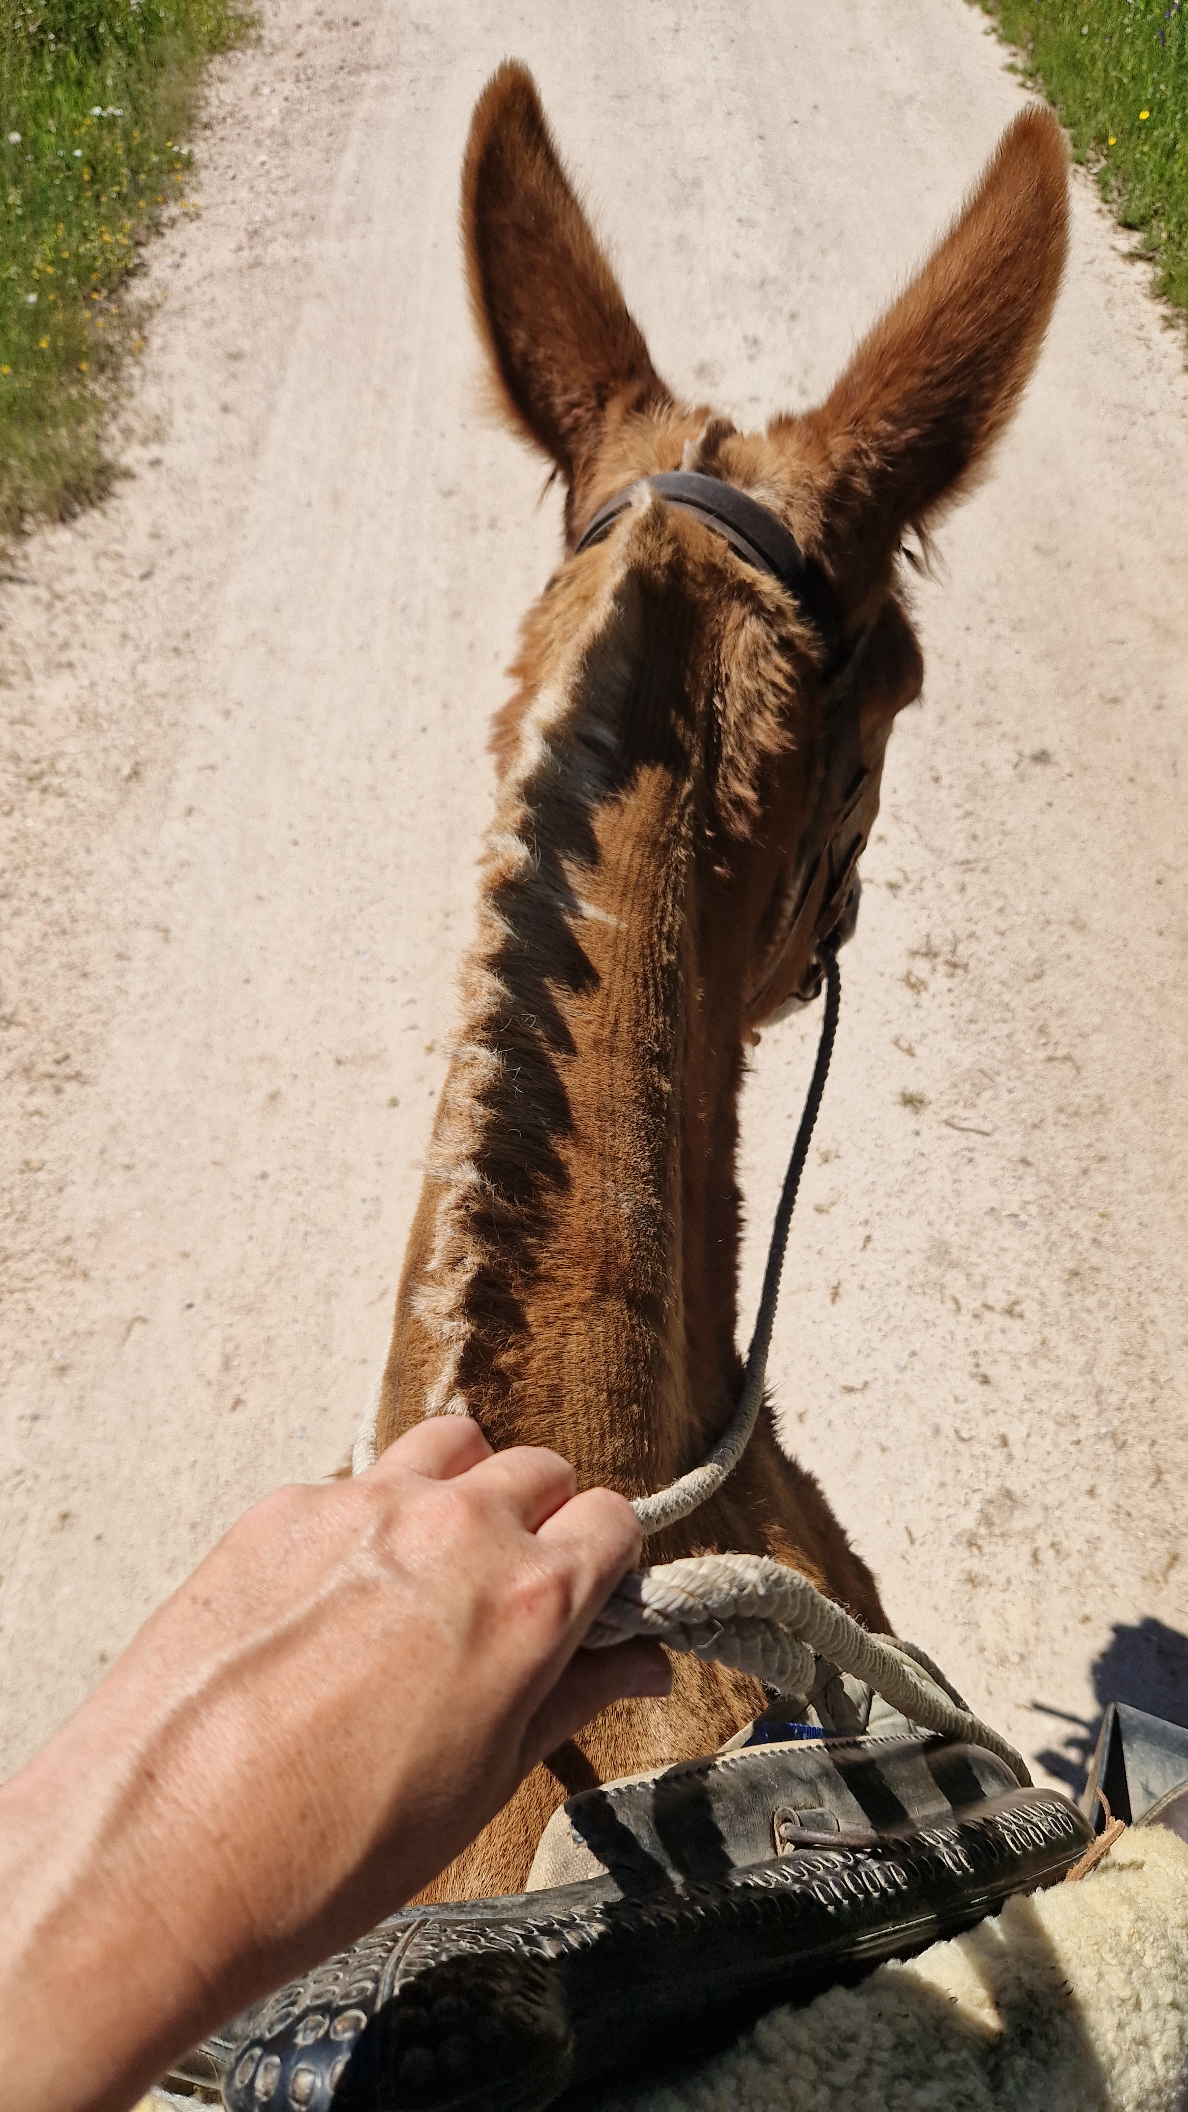
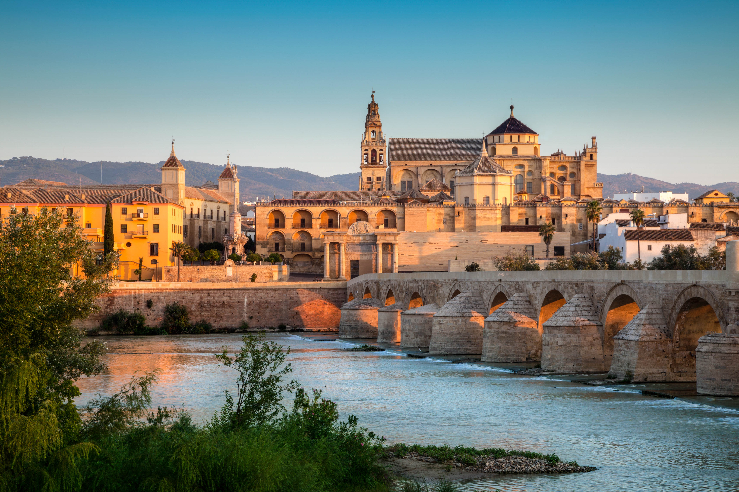
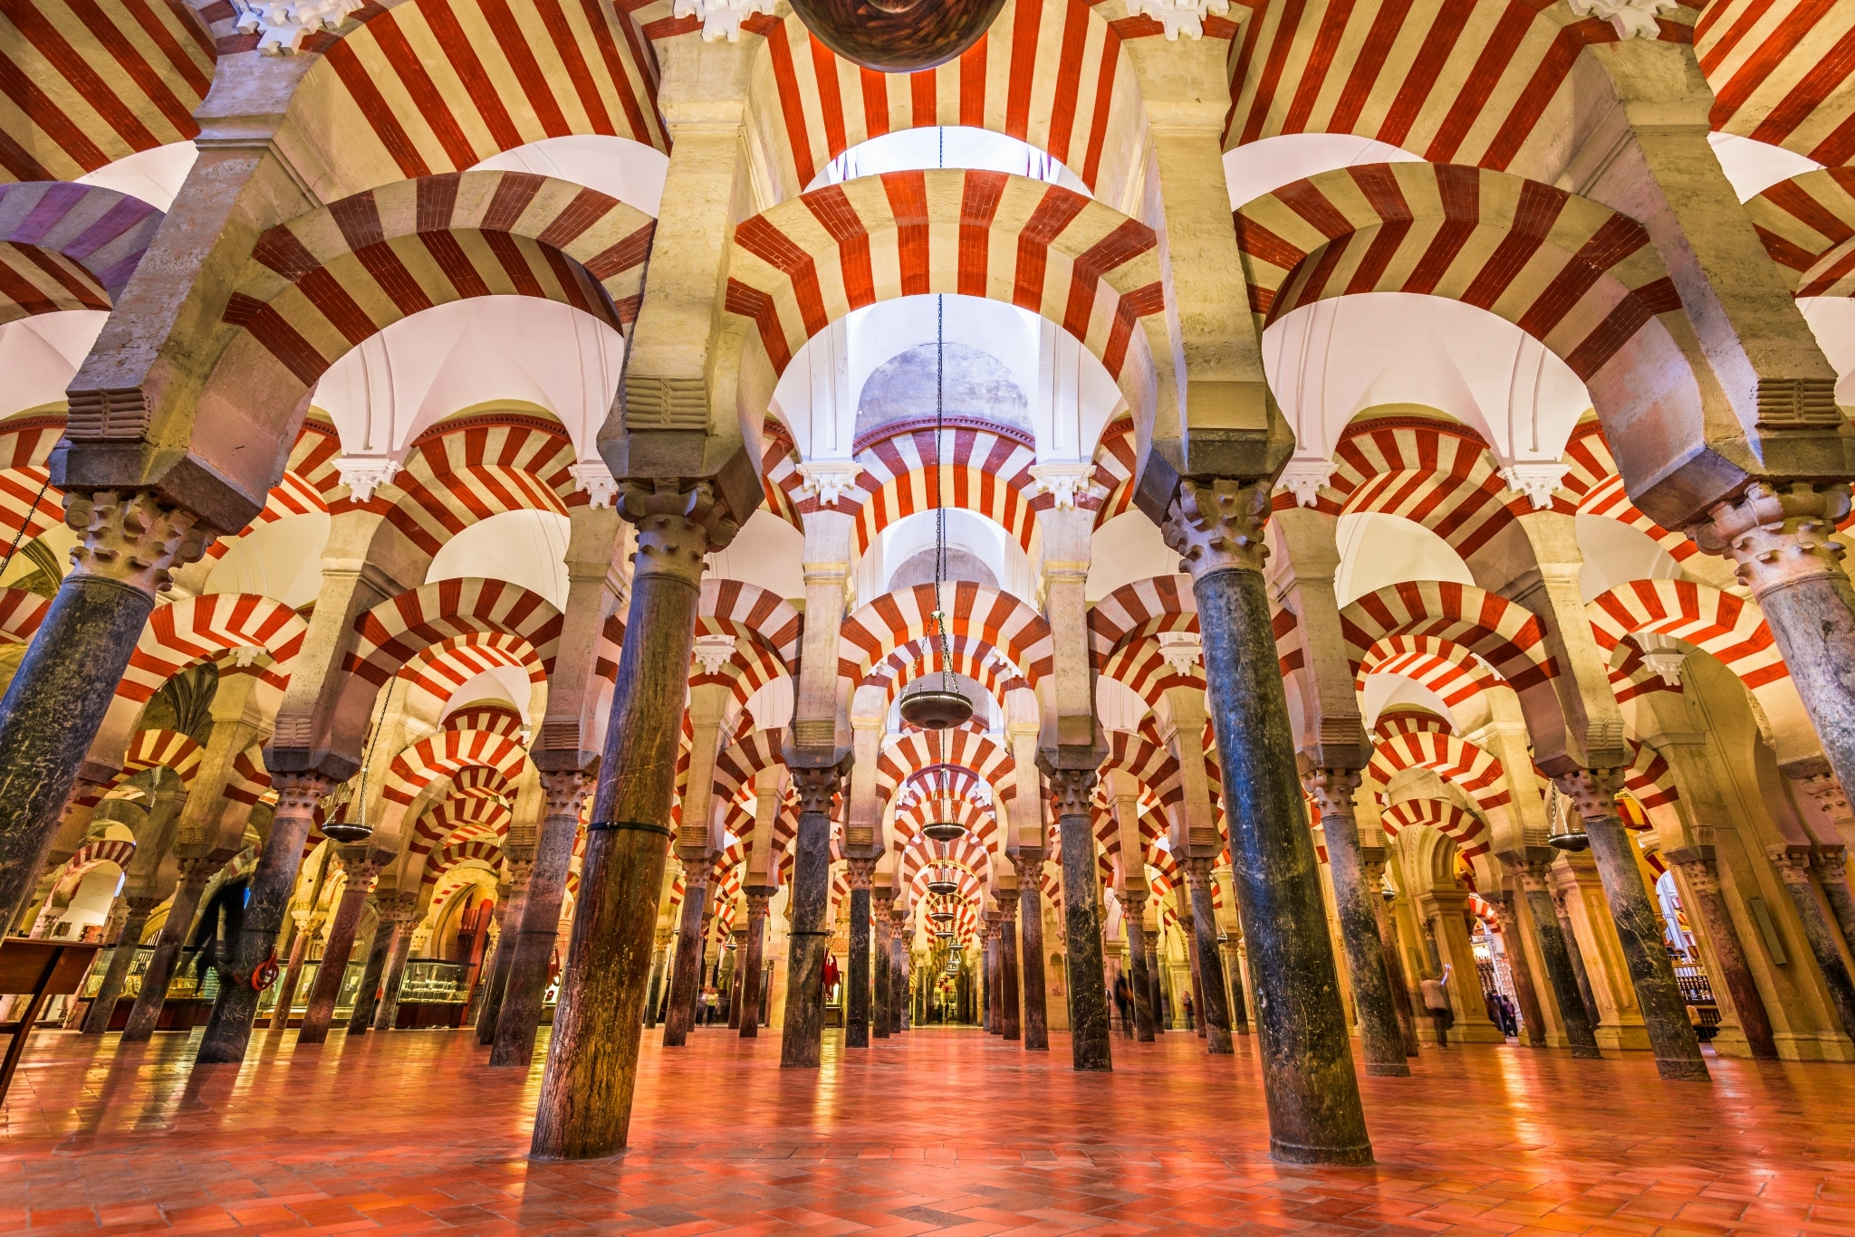
HORSEBACK ADVENTURES
TRAVEL PROGRAM
Day 2.
Day ride in Sierra de Cardeña and night tour of the Mosque-Cathedral.
Day ride through the Sierra de Cardeña, on saddle mules. Southern Spain is one of the very last places in Europe where mules are still used today for forestry work and during traditional festivities. They are highly valued and more expensive than horses nowadays. Our outfitter has a herd of more than 80 working animals. If you´ve never ridden a mule, you will find it´s not much different than a horse and something worth trying! During our ride we will go through cork and holm oak forests, where we will find a nice shade to make a picnic. Total riding time: 4hr.
Once back in Córdoba, in the evening, we will be treated to a night visit to the inside of the Mosque-Cathedral, which gains a very impressive air as it is artistically lit at night.
2nd night in Córdoba., 4* accommodation.

Slide 4
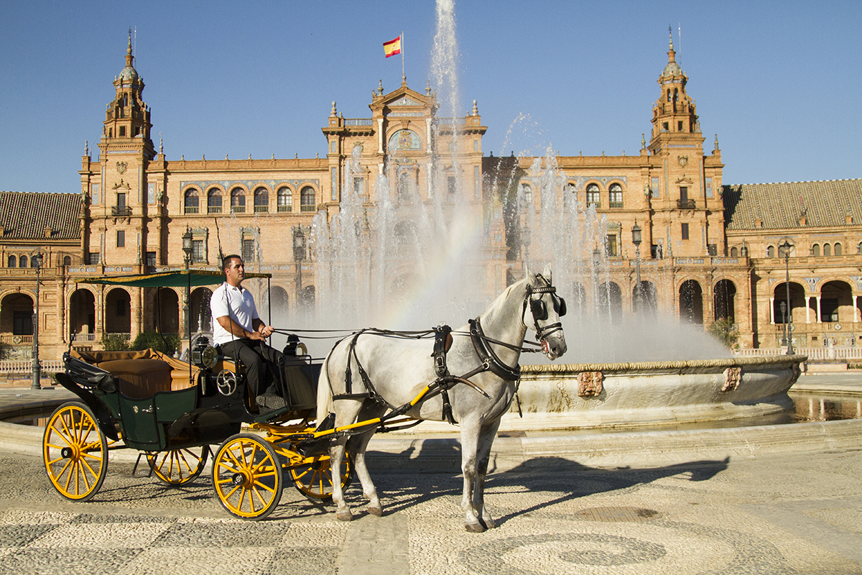
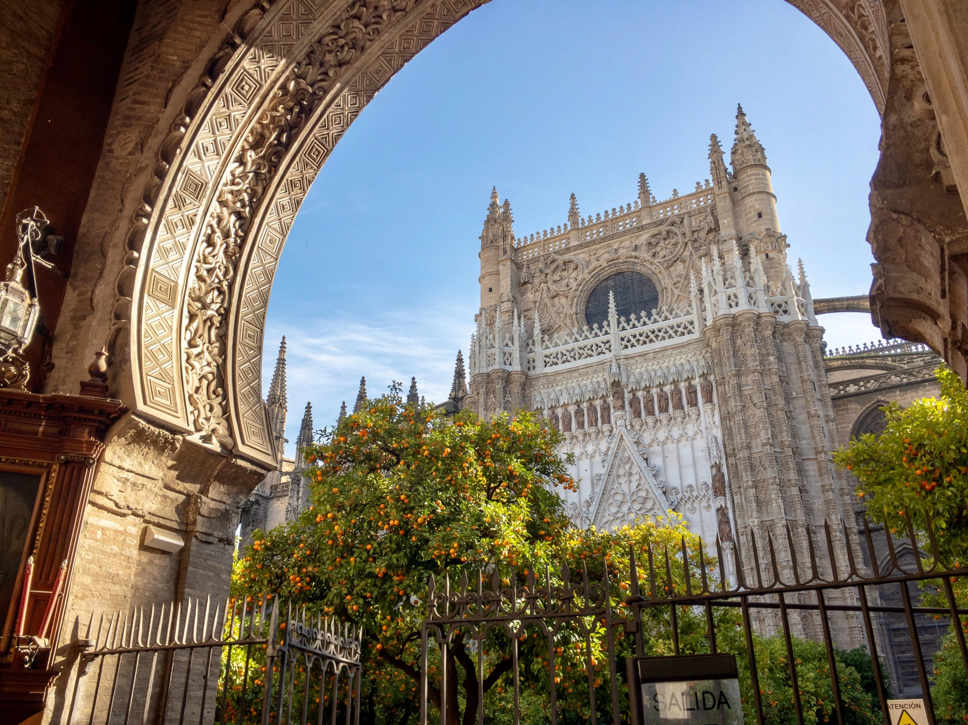
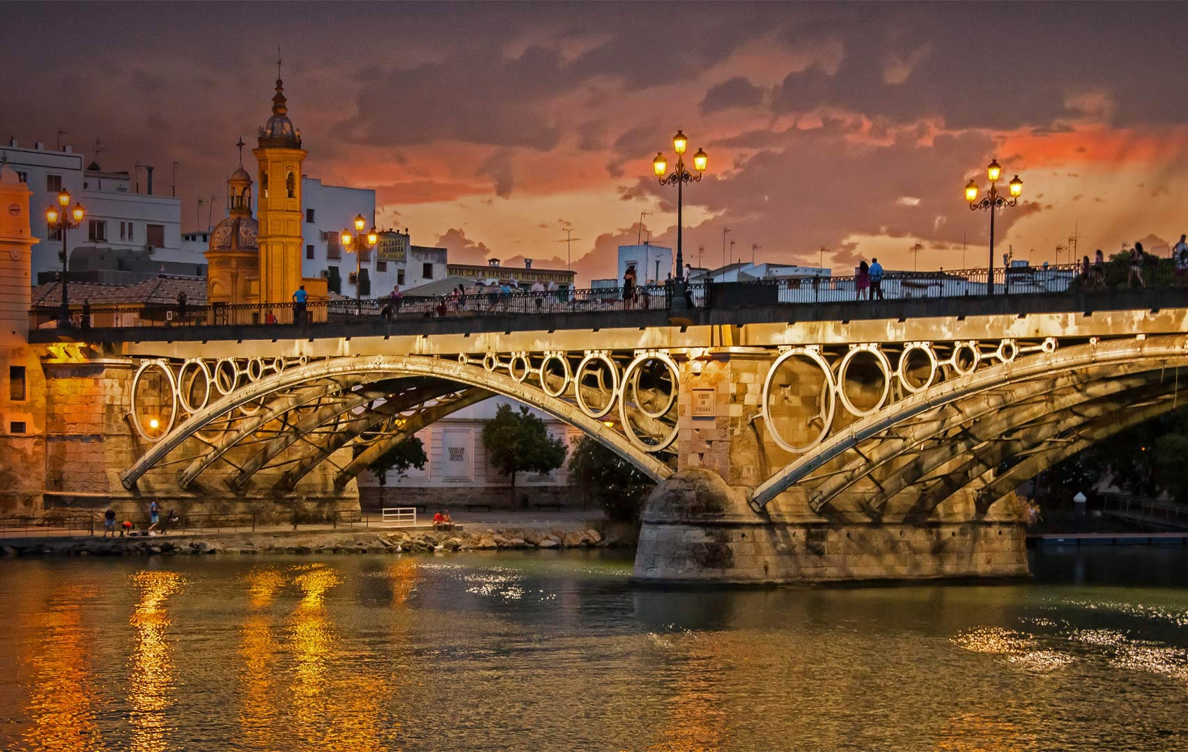
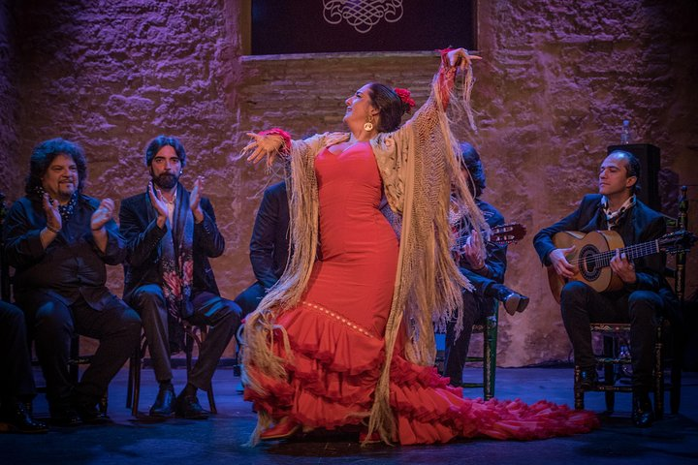
HORSEBACK ADVENTURES
TRAVEL PROGRAM
Day 3.
Seville highlights, classic horse buggy tour.
Transfer to Seville (1hr 40m drive) The capital of Andalucía: elegant, rich with historical buildings and gardens, traversed by the Guadalquivir River. We will tour the city on a traditional horse buggy to see the main sights: Plaza de España, Alcazar Palace, Maria Luisa Gardens, Torre del Oro, etc.
After lunch, a must-see: inside the Seville Cathedral with its mind-blowing gold main altar and the burial site of Christopher Columbus.
In the evening, a flamenco dinner show in the lively Triana neighborhood will complete the day´s experience.
1st night in Seville., 4* accommodation.

Slide 5
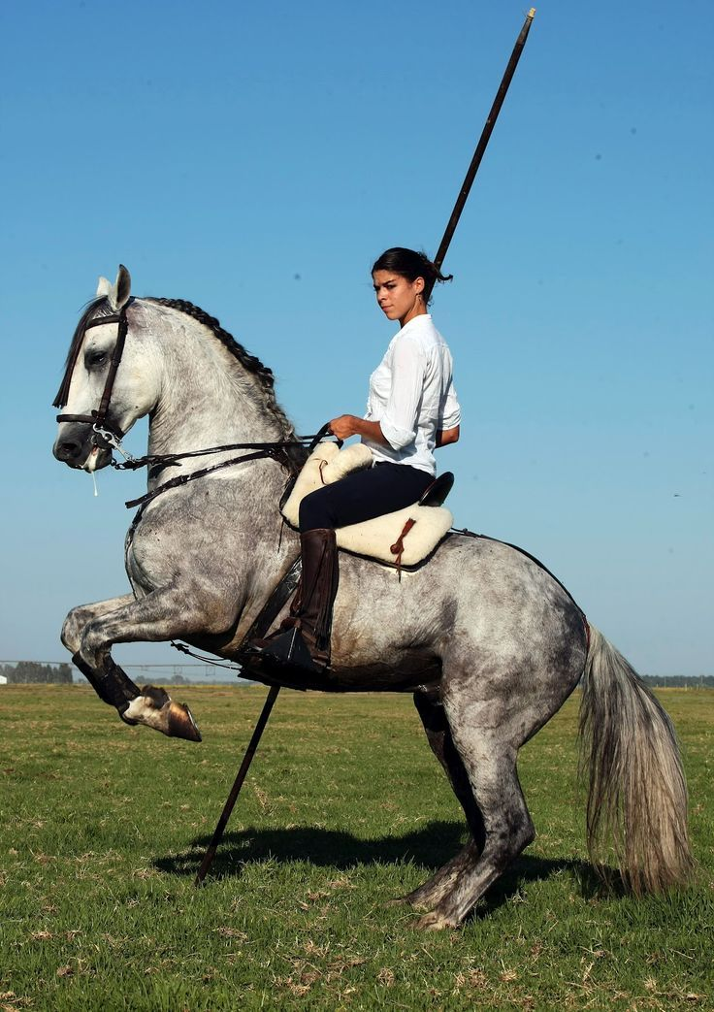
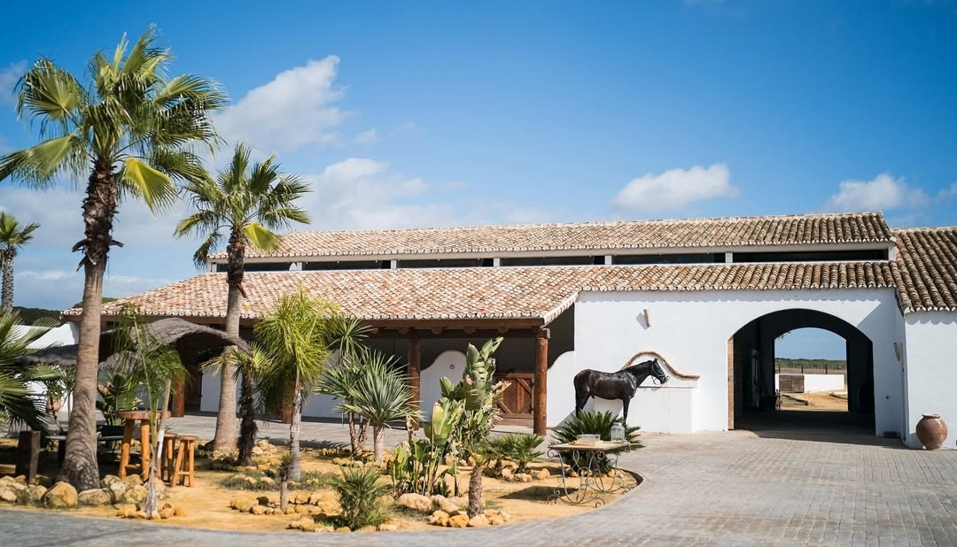
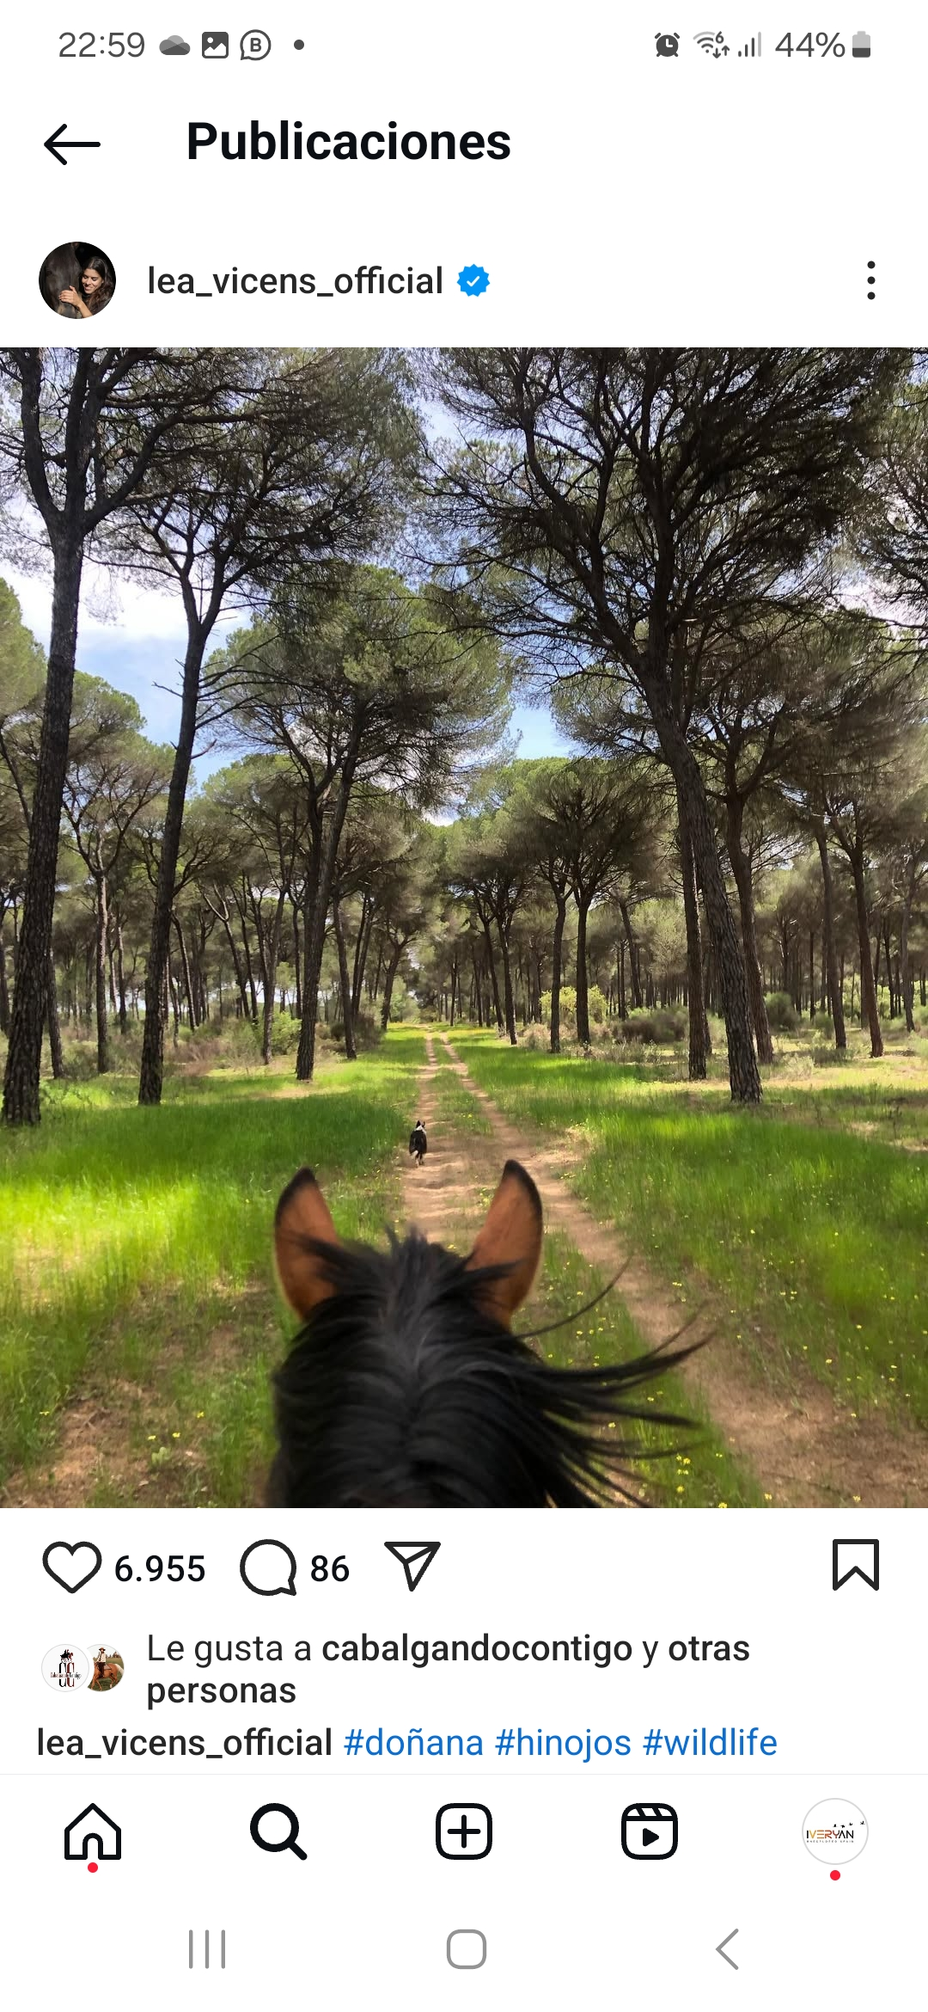
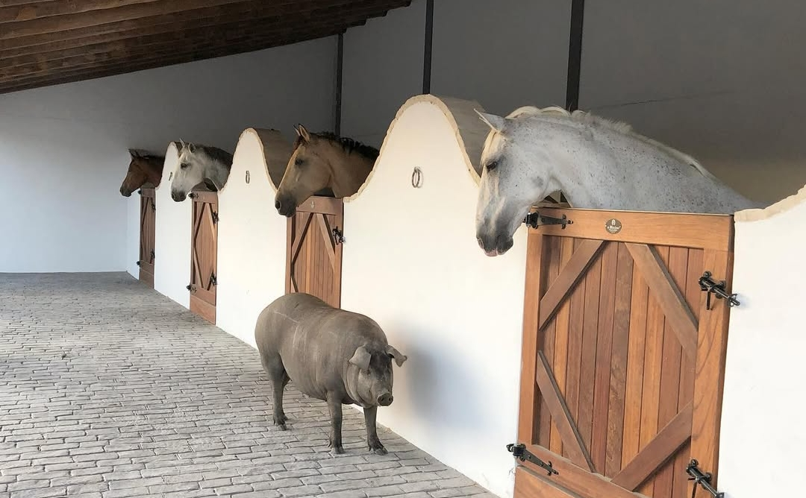
HORSEBACK ADVENTURES
TRAVEL PROGRAM
Day 4
Day ride in Doñana Natural Park.
Only a short drive out of Seville, we will find a landscape shaped by the delta of the Guadalquivir river, with a mix of farmland, marshes and pine nut forests growing over a soft terrain of sand dunes. Both livestock and game keep a maze of trails and it makes for an excellent riding terrain.
Our hostess here is an exceptional woman, Lea Vicens, who breeds and trains Lusitano and Spanish Purebred horses. A true defender of Spanish traditions, she has excelled in the art of rejoneo, fighting the bulls from a horse. She will give us a tour of her beautiful farmstead and stables, give us a glimpse of what its like to train for this very particular and little-known equestrian discipline and we will have a good day´s ride on her amazing horses.
Total riding time: 4hr.
2nd night in Seville., 4* accommodation.

Slide 6
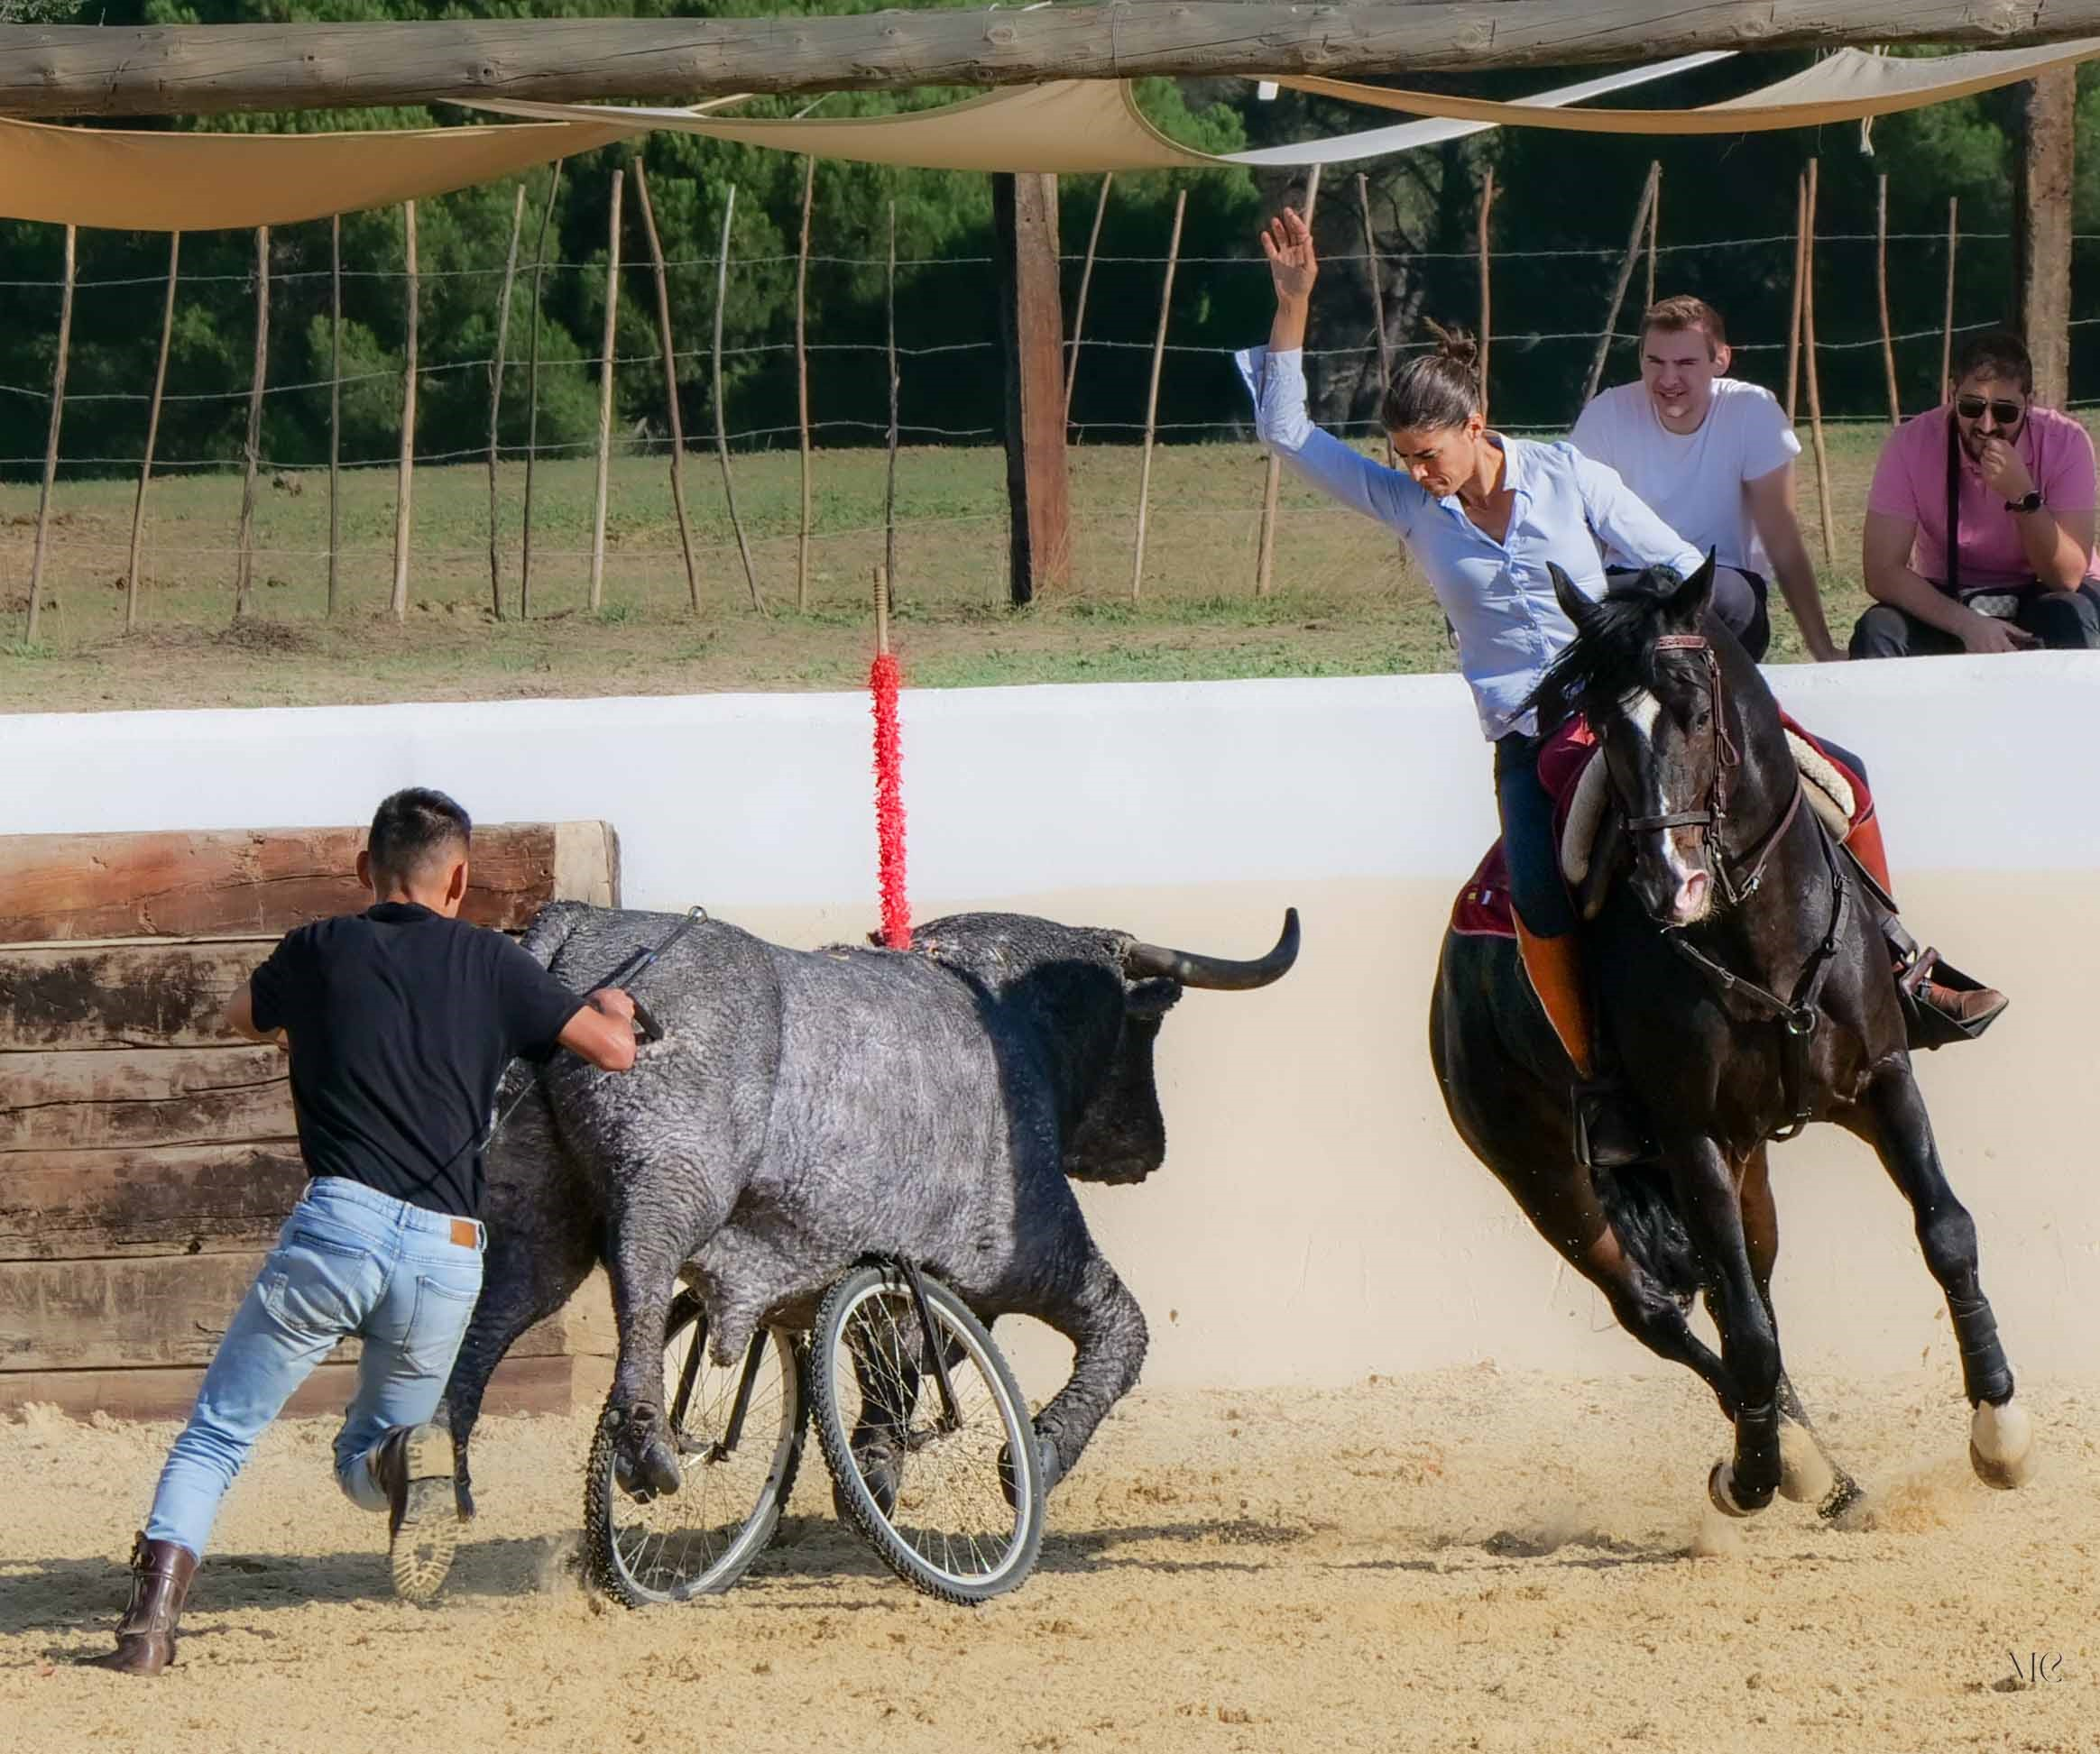
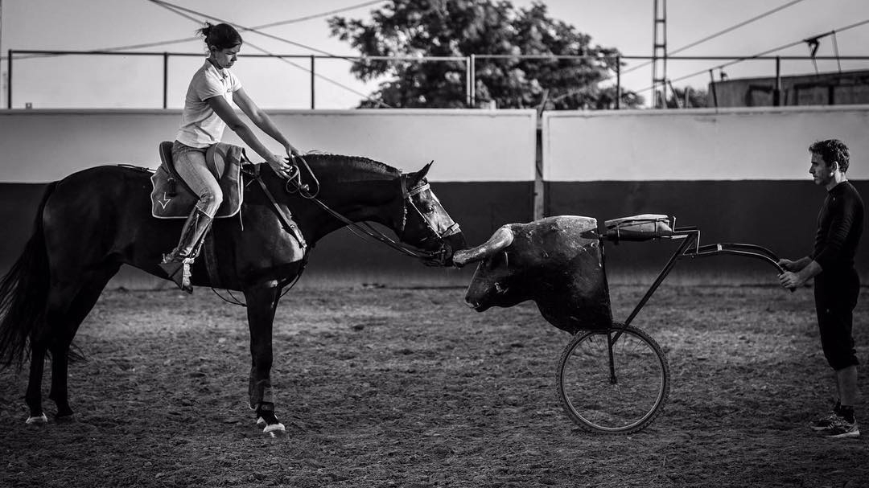
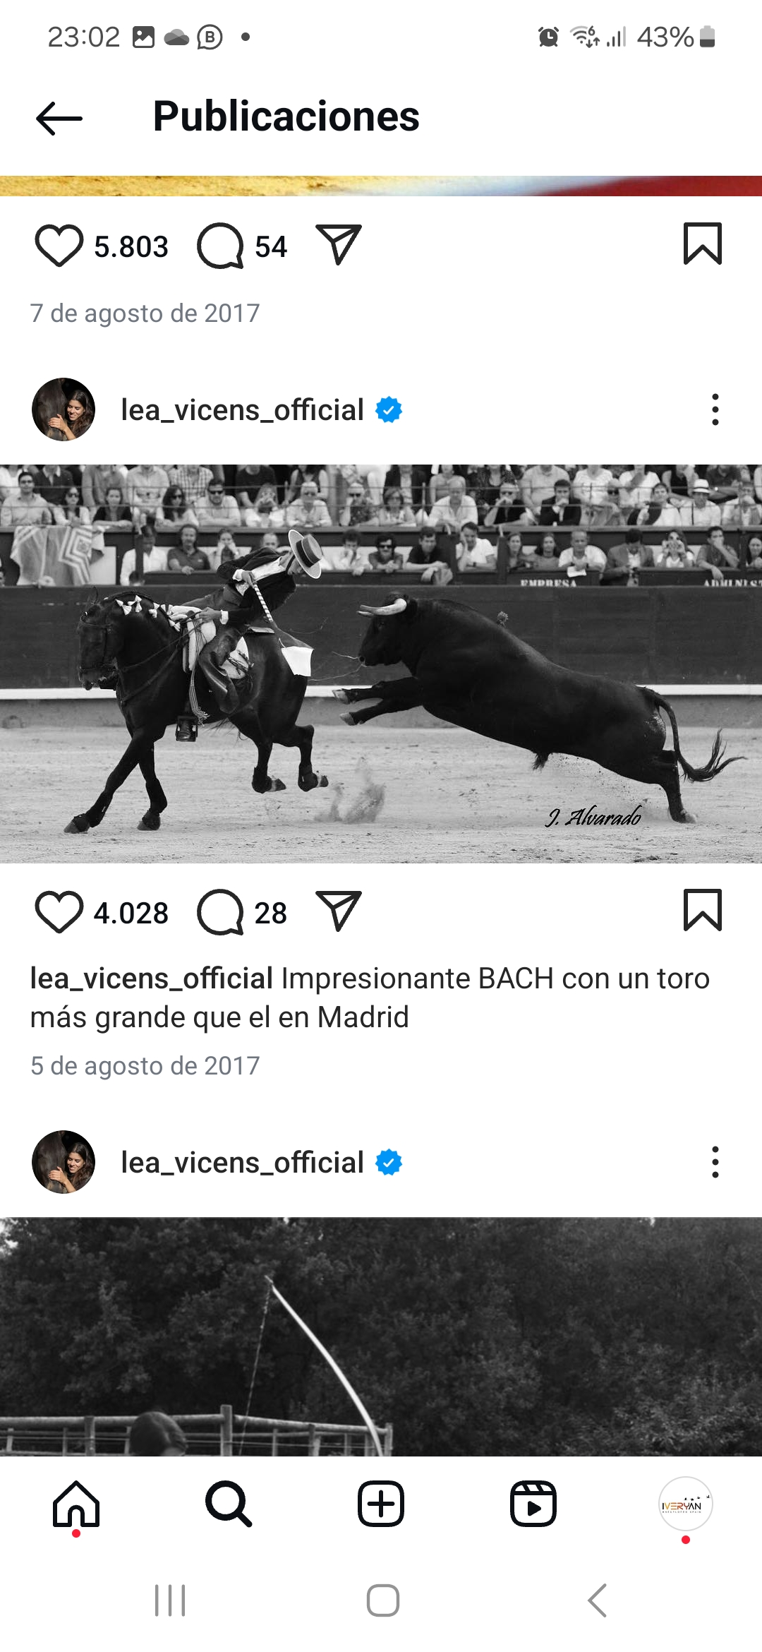
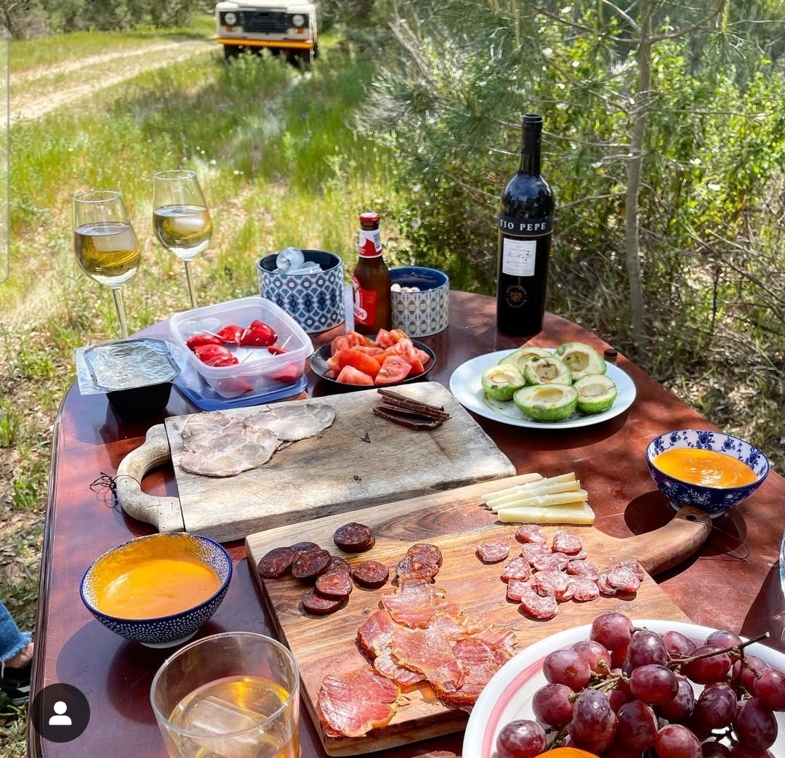
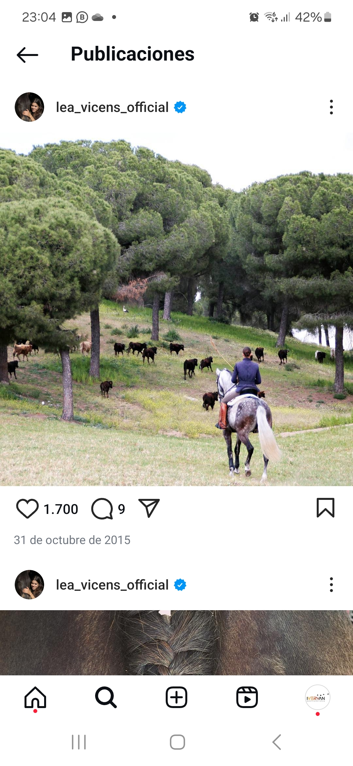
HORSEBACK ADVENTURES
TRAVEL PROGRAM

Slide 7
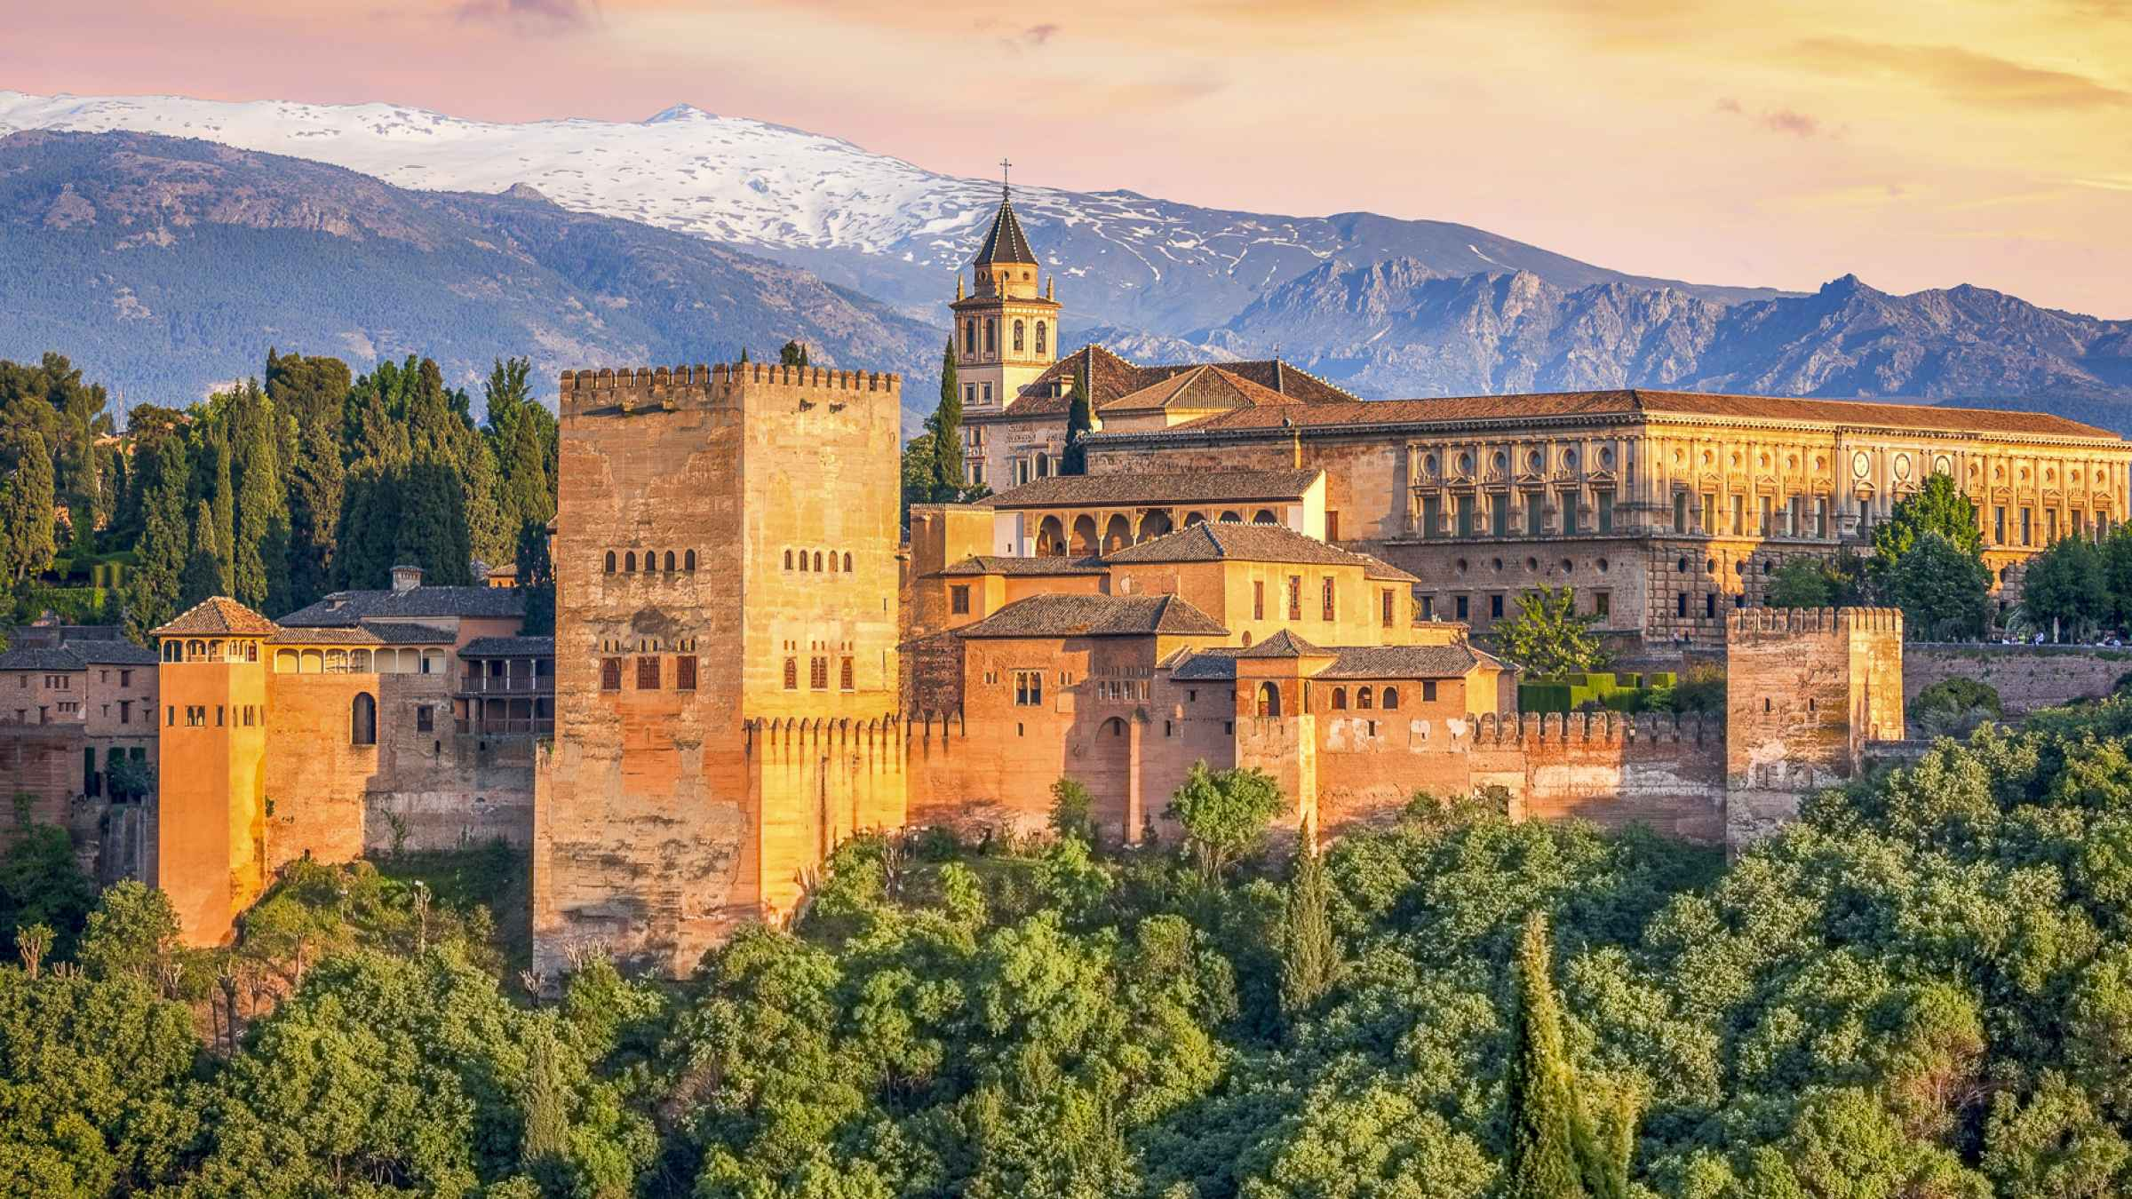
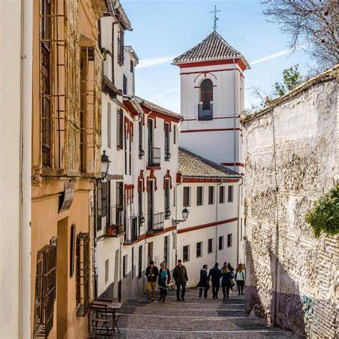
TRAVEL PROGRAM
Day 5.
Granada, visit to Alhambra Palace complex
In the morning, transfer to Granada (2hr 30m drive) . Private tour of the Alhambra Palace complex. One of the highlights of this trip, it is one of the most famous monuments of Islamic art and Spanish Renaissance architecture. The complex was begun in the XIth century and housed a succession of sultans in the times of the Emirate of Granada, the last Muslim state of Europe, falling to Christian rule in 1492. (*Duration of Alhambra tour: 3 hr.)
In the evening, free time to stroll through the laberynth of white washed houses and cobblestone streets of the Albayzin neighborhood and city center. This is considered one of the most beautiful cities in the world, and in its small size, it is packed with charm and history.
1st night in Granada., 4* accommodation.

Slide 8
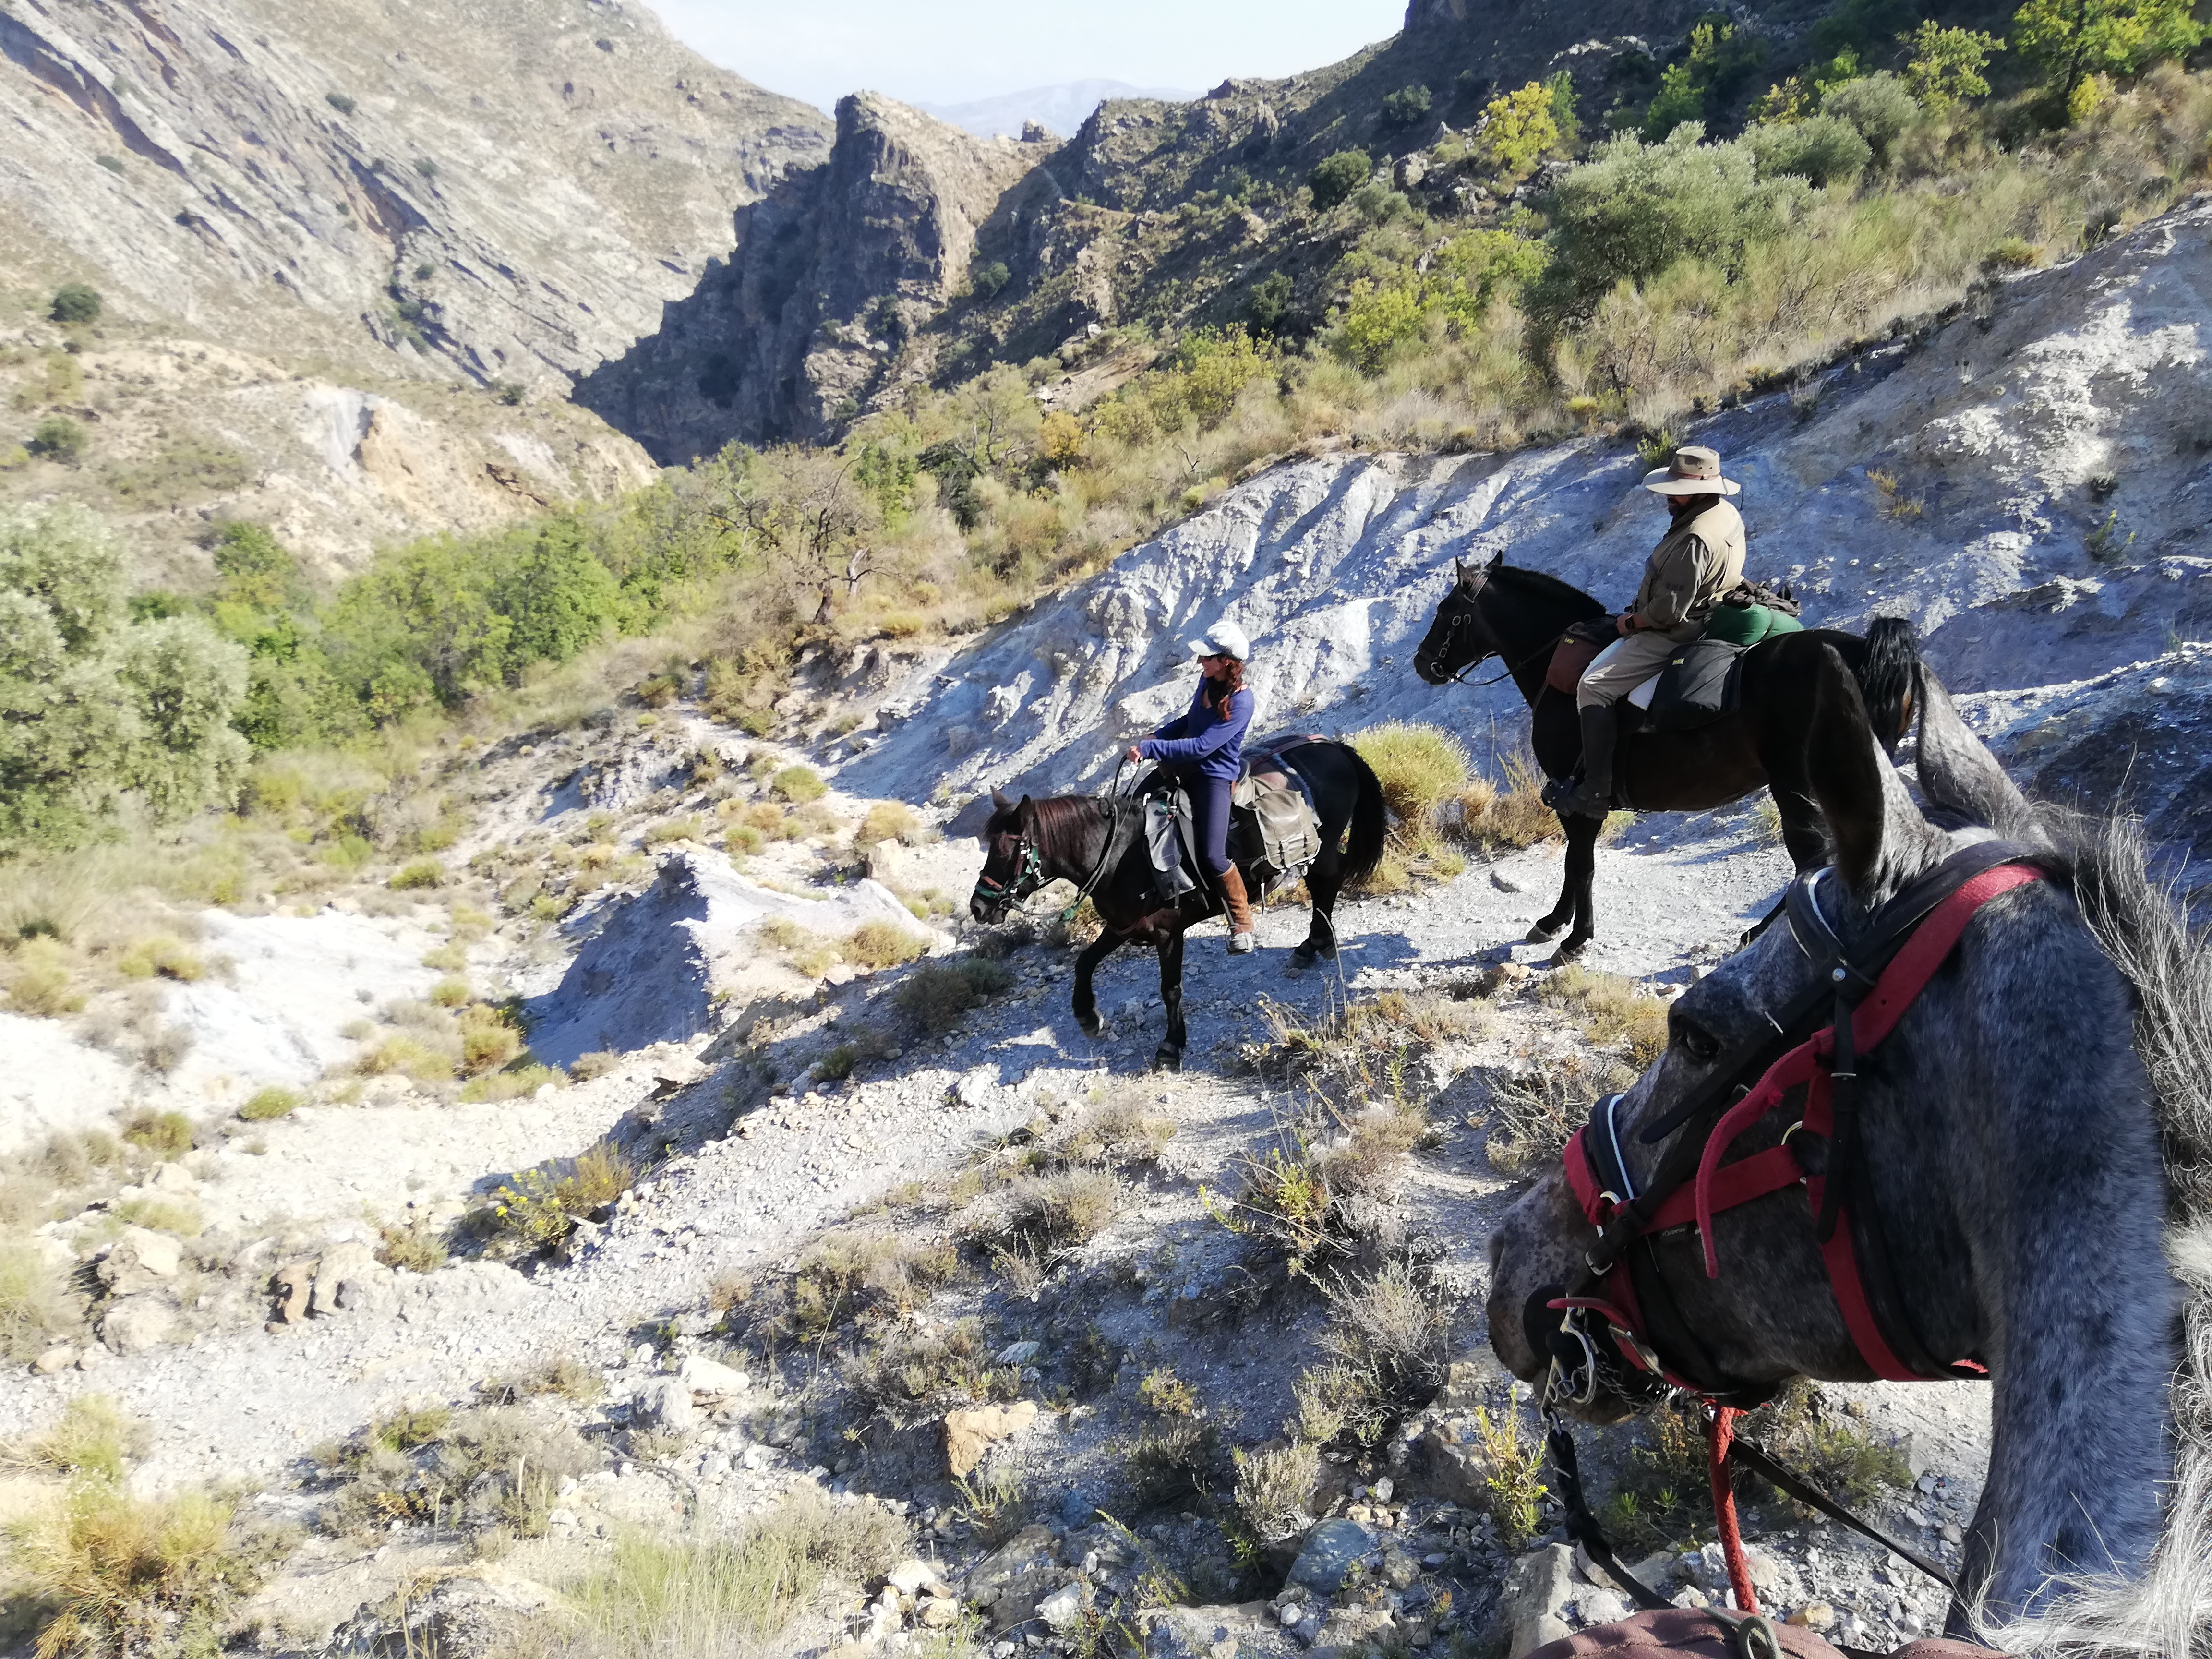
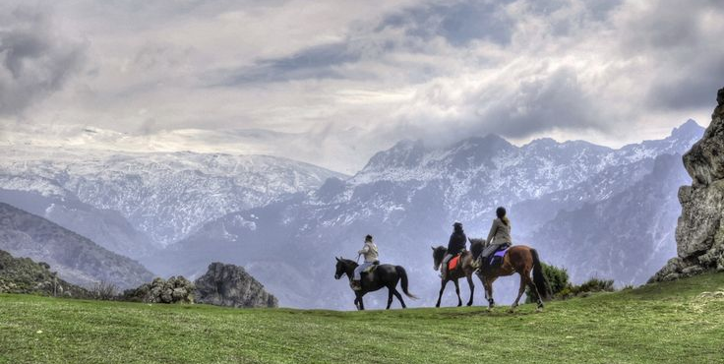
HORSEBACK ADVENTURES
TRAVEL PROGRAM
Day 6. Day ride in Sierra Nevada.
Sierra Nevada is the highest mountain range in Spain. It is higher even than the Pyrenees. It abruptly climbs from sea level to its 3000+ meter summits over a series of steep gorges that make for an unexpected scenery.
*Depending on the time of year we will choose the trail at lower or higher altitude. Total riding time: 4 to 6 hr.
Once back in Granada, we will have a special farewell dinner.
2nd night in Granada., 4* accommodation.
Day 7. Transfer to Madrid airport
Suggested departure: 9:00am, estimated time of arrival at Madrid airport 14:00.
End of service.

Slide 9
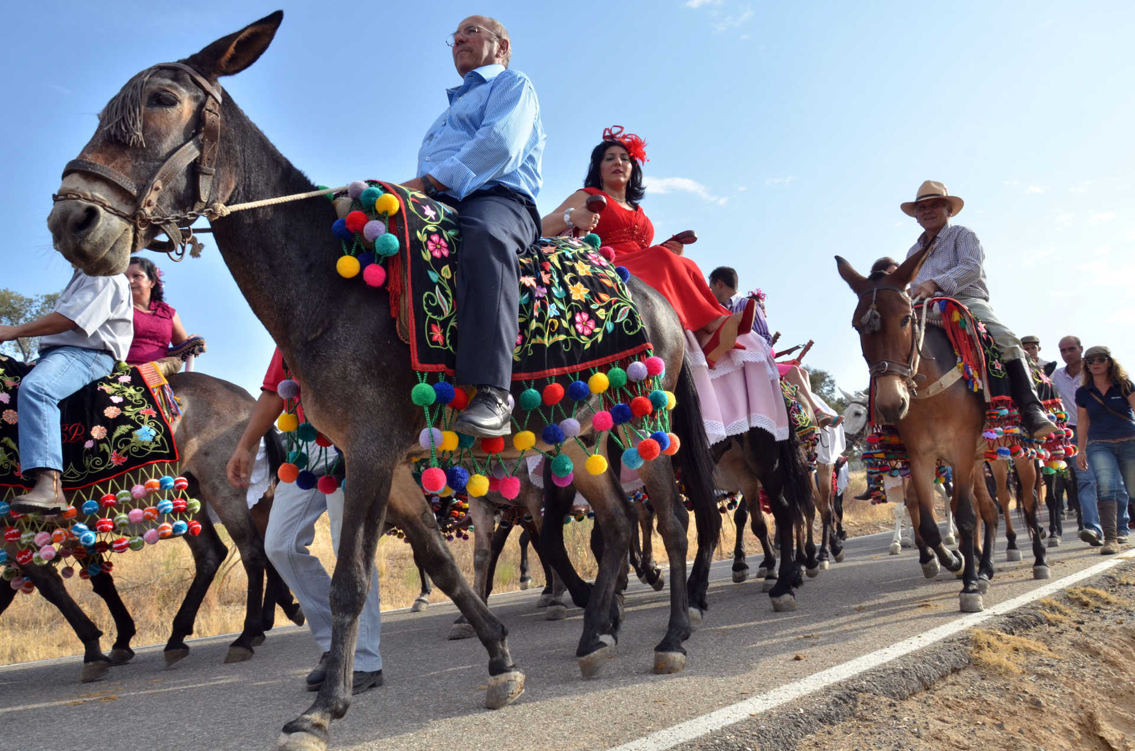
HORSEBACK ADVENTURES
TRAVEL PROGRAM
THE TRIP INCLUDES
Private transfers by road, to/from the international airport or accommodation in Madrid.
Accommodation in 4* hotels, selected among the best of each area. 2 nights in Córdoba, 2 nights in Seville, 2 nights in Granada.
All meals: Breakfasts at the hotel, lunches and dinners in different types of restaurants, "de tapas" in typical taverns. Restaurants have been carefully selected to enjoy the local dishes of each region. Regular drinks at meals included, extra drinks will be at the client´s expense.
Horses, tack and guides for the trail rides.
Programmed visits as described in this brochure (tickets and local guides).
IVERYAN staff will accompany the group to guide and assist the travelers in everything they need throughout the trip.
7 days – 6 nights
3 days riding
3 days city touring
Dates :
September to May
Price:
Around 400-500€ per person/night.
Depending on dates, group size and final program.
This program has been designed by Iveryan and is modifiable to the clients´ requirements.
The travel program is indicative, and is subject to modifications depending on weather conditions, delays, cancellations, temporary closure of any of the accommodations or any other circumstance beyond IVERYAN's control. However, the essence of the trip will remain unchanged and possible modifications will not substantially affect the experience.
Contact:
Francisca Guzmán Lobo
iveryan@iveryan.travel
+34 652 280 472 (Whatsapp)

